Slide 1
CH2PH2:
Surfaces and Interfaces
Dr. James Hallett
j.e.hallett@reading.ac.uk

Slide 2
CH2PH2
Lecture 2: Self-assembly, surfactants and micelles

Slide 3
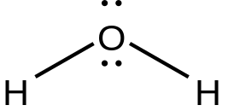
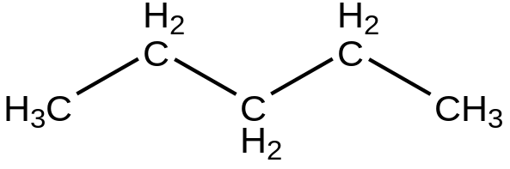
Surfactants
Surfactants are amphiphilic: contain both hydrophilic and solvophilic (hydrophobic) groups
In order to dissolve well, a solute must be able to interact with the solvent well. What types of interactions do polar solvents make with solutes versus non-polar solvents?
Has a dipole, so it wants to make
Ion/dipole
Dipole/dipole
Dipole induced dipole
So the solute must have a charge, dipole, or polarizability
Has no charge, dipole, or double bonds
Only dispersion
So the solute should be one that can engage in dispersion only.
If the solute can form interactions other than dispersion, it will interact more strongly with water

Slide 4
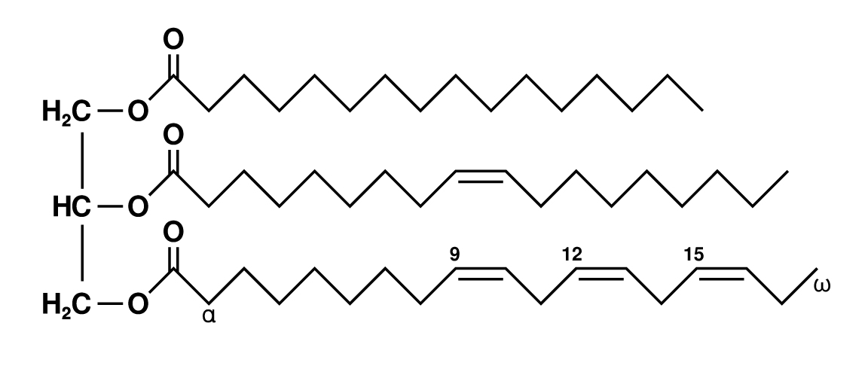
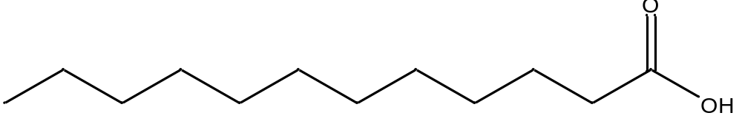
Surfactants
This result is commonly expressed as like dissolves like.
Is water going to want to dissolve the fat?
The soap dissolves the fat, and the water dissolves the soap.
How does the lauric acid help the fat dissolve in the water?

Slide 5
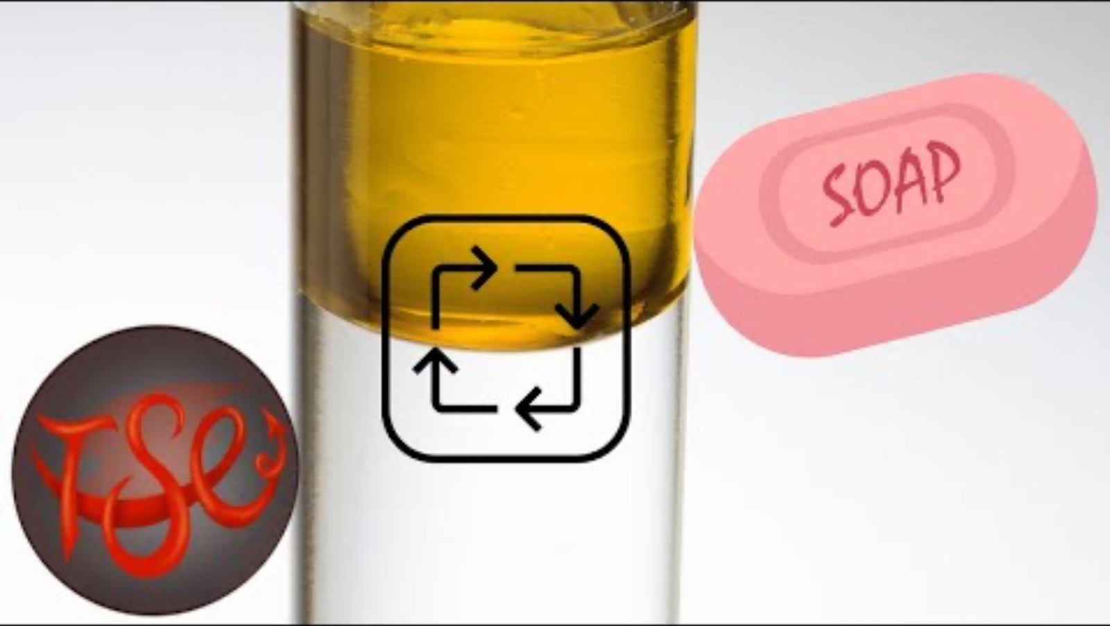
https://youtu.be/sbCODXfczCg?si=3cit8_MyD7Dl2B19&t=72

Slide 6
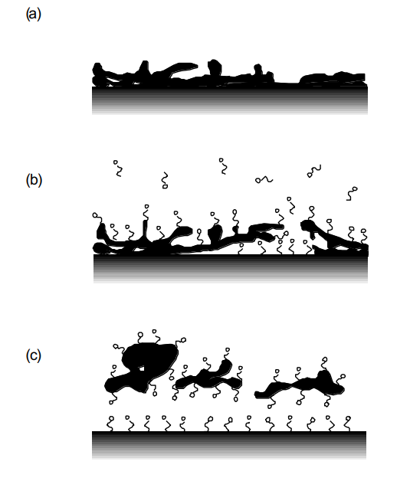
Surfactants
Small fat droplets are encapsulated by the soap, allowing them to be solubilised by the water
Notes:
https://youtu.be/rrMsDRsXnHM

Slide 7
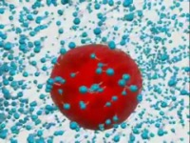
https://youtu.be/rrMsDRsXnHM

Slide 8
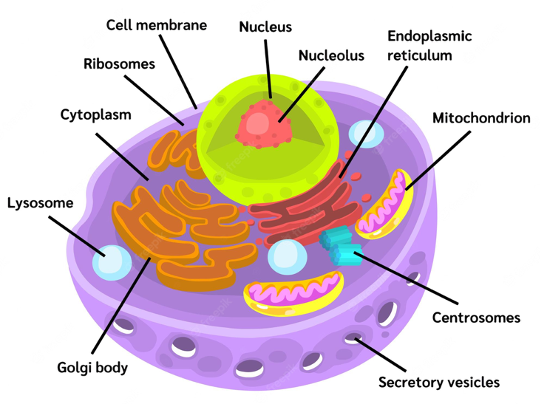
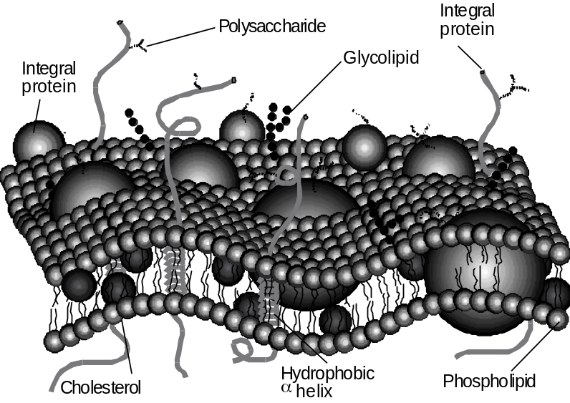
Surfactants
A common application of surfactants is the formation of cell membranes.
Phospholipids (phosphate bearing fats)
Glycolipids
cholesterol

Slide 9
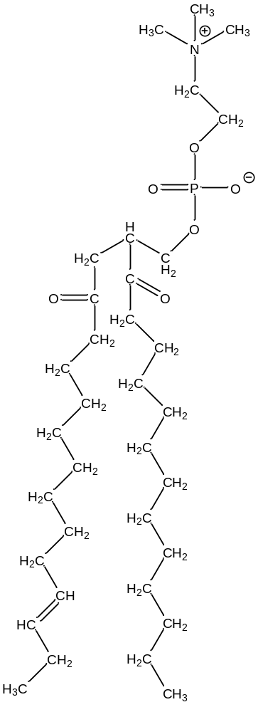
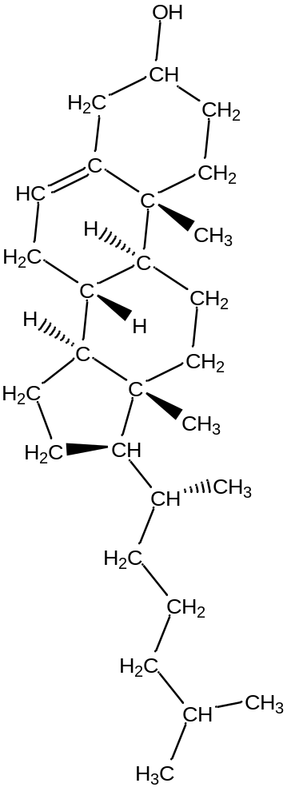
Surfactants
Strong Forces
Phosphatidylcholine
Cholesterol
What happens if we put these molecules into water (blood)?
Weaker Forces

Slide 10

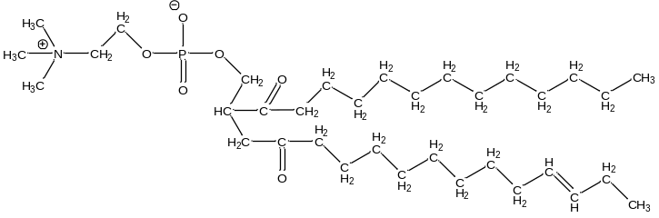
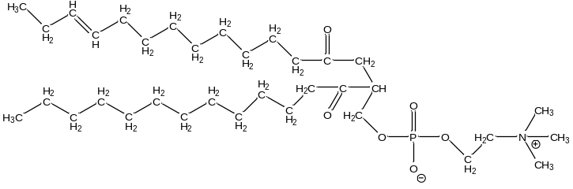
Surfactants
Exposed to water/blood
Kept ‘inside’

Slide 11
Surfactants
Outside of cell – blood (mostly water)
The water maximises the number of polar interactions by minimizing its interaction with non-polar hydrocarbon tails - resulting in membrane formation
Inside of cell – cytosol (mostly water)
Thus, cell membranes are polar/charged on the outside, and very non-polar inside.
The occasional presence of cholesterol makes membranes stronger and more fluid.
Notes:
The cell membrane is held together simply by the fact that the hydrocarbon chains do not want to interact with water, since water has hydrogen bonds, and the chains have only dispersion/induction.

Slide 12
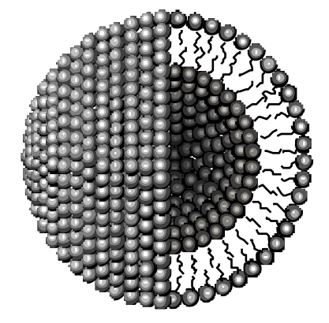
Surfactants
You can also use amphiphilic molecules to form liposomes:
Liposomes are formed by lipids in a similar way to cell membranes
Can be used for drug delivery and cosmetics encapsulation.

Slide 13
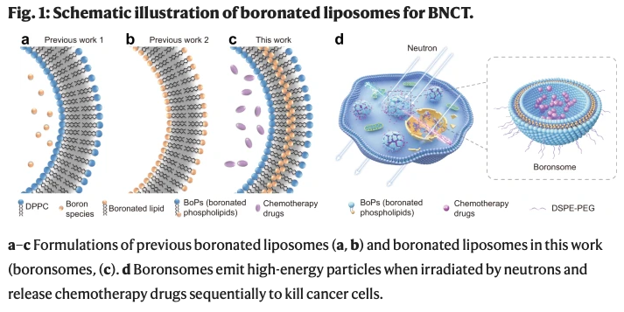
Lipids and boron neutron capture
¹⁰B + n → ⁷Li + 𝛼
Alpha particle – very short ranged, but very strongly ionizing! Powerful alpha emitters include polonium-210
Li, J., Sun, Q., Lu, C., Xiao, H., Guo, Z., Duan, D., ... & Liu, Z. (2022). Boron encapsulated in a liposome can be used for combinational neutron capture therapy. Nature Communications, 13(1), 2143

Slide 14
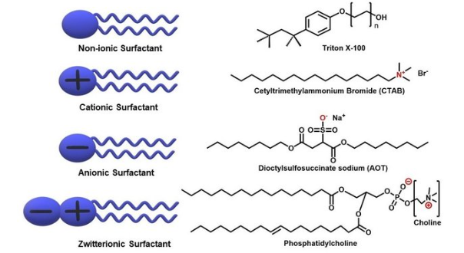
Designing a surfactant
Near-infinite number of different molecules are amphiphilic, but there are some common “design rules”.
Typically* amphiphiles have a region that is more polar and a region that is less polar (non-polar)
We often picture amphiphiles as having headgroups and tails
The headgroup is usually* more polar and the tail is usually* less polar
The headgroup can be non-ionic, cationic, anionic or zwitterionic, the tail is not charged*.
*as always there are exceptions

Slide 15
Designing a surfactant

Slide 16
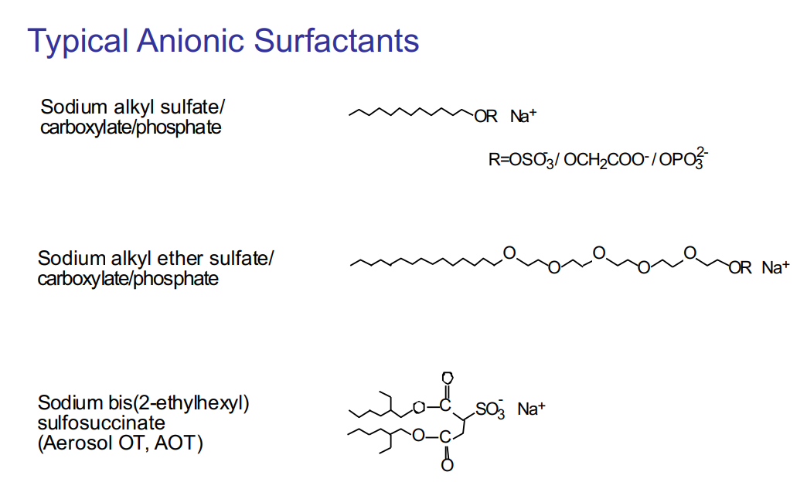
Surfactants

Slide 17
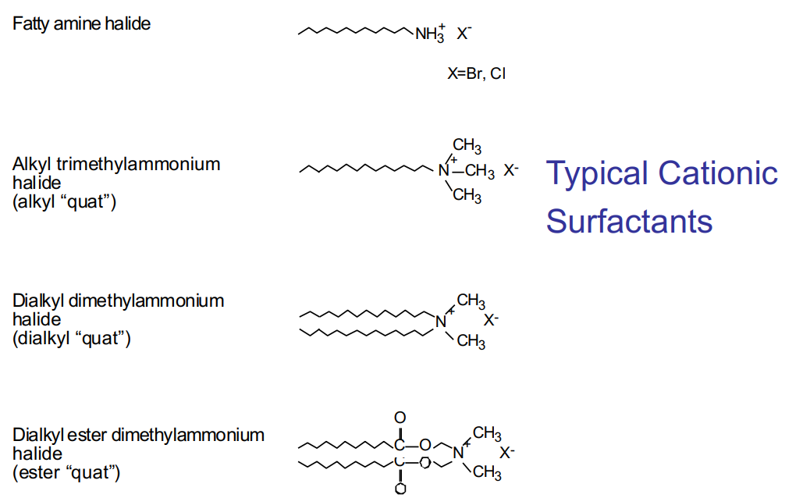
Surfactants

Slide 18
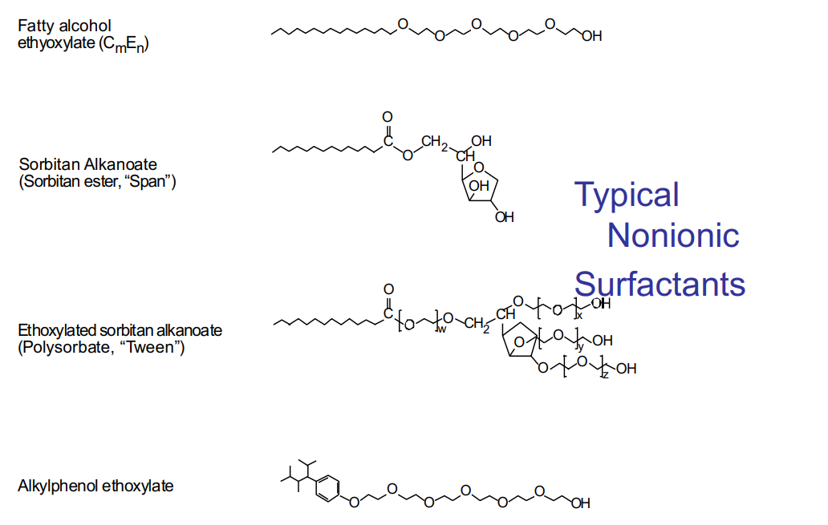
Surfactants

Slide 19
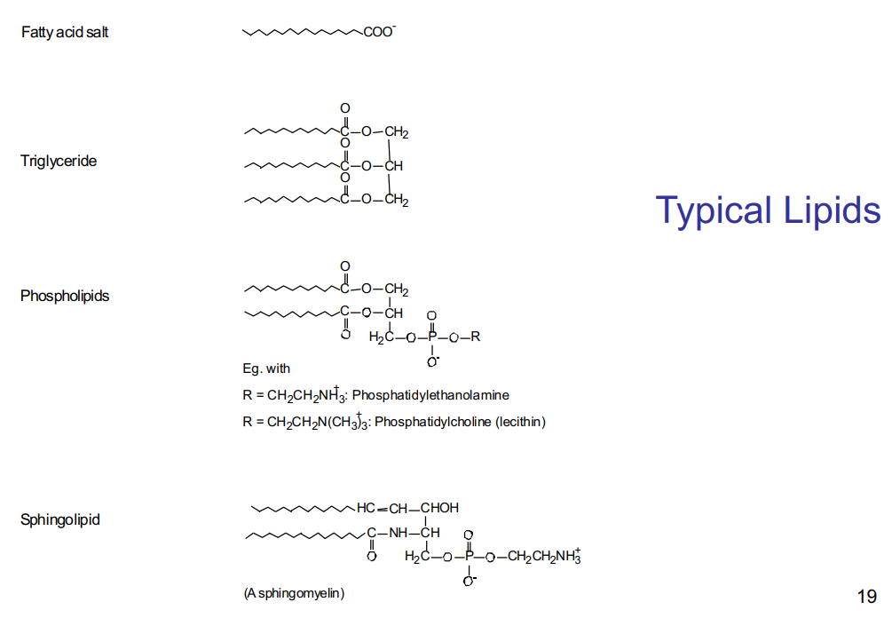
Surfactants

Slide 20
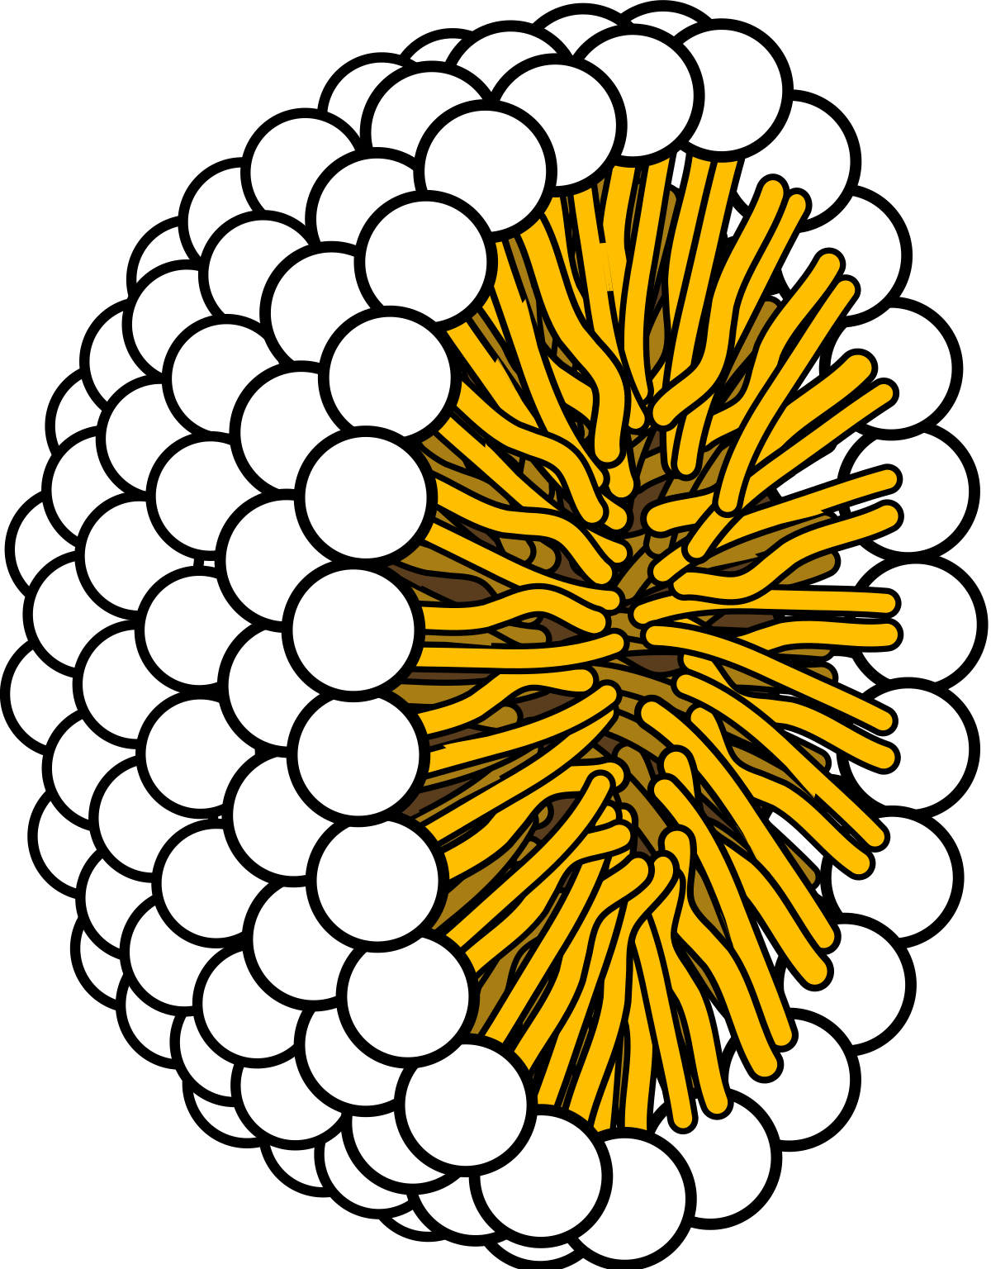
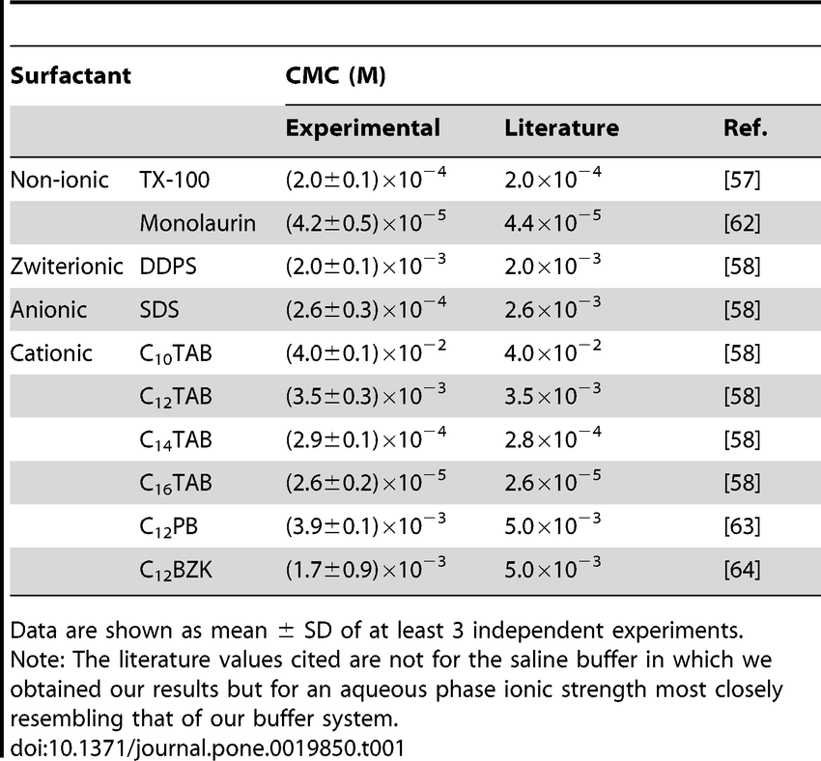
Micelle formation
To avoid contact of hydrophobic groups with water, amphiphiles self-assemble into micelles above a certain concentration – the Critical Micelle Concentration (cmc)

Slide 21
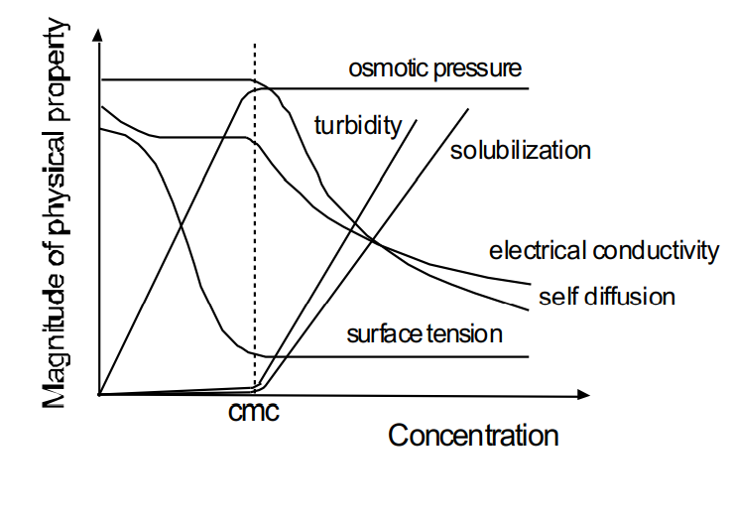
Critical micelle concentration
The cmc is not a thermodynamic phase transition. It is defined phenomenologically by a sharp increase in the number of molecules associated into micelles
It can be measured via colligative properties, or from techniques sensitive to the dynamics of molecules

Slide 22
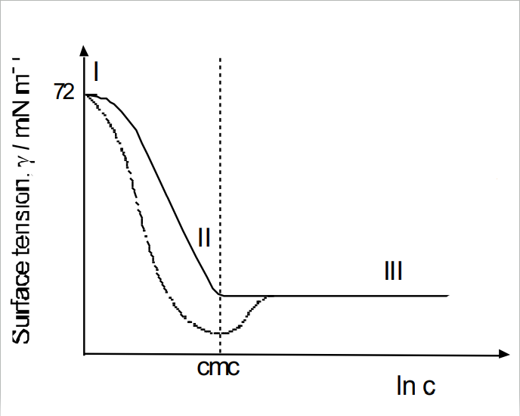
Surface tension
Surface tension measurements are perhaps the most common way to measure cmc
Addition of many organic molecules causes reduction in surface tension of an aqueous solution
In contrast, for salts, surface tension increases because ions are depleted from the surface due to bulk interactions.
For surfactants, the decrease in surface tension with increasing conc shows a discontinuity at the cmc
Solid – pure surfactant
Dashed – impure surfactant

Slide 23
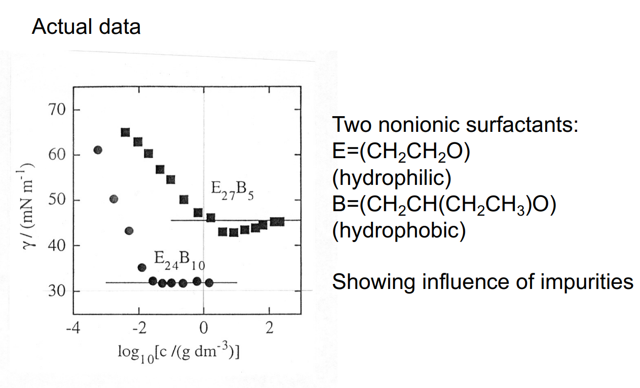
Surface tension and micelles

Slide 24
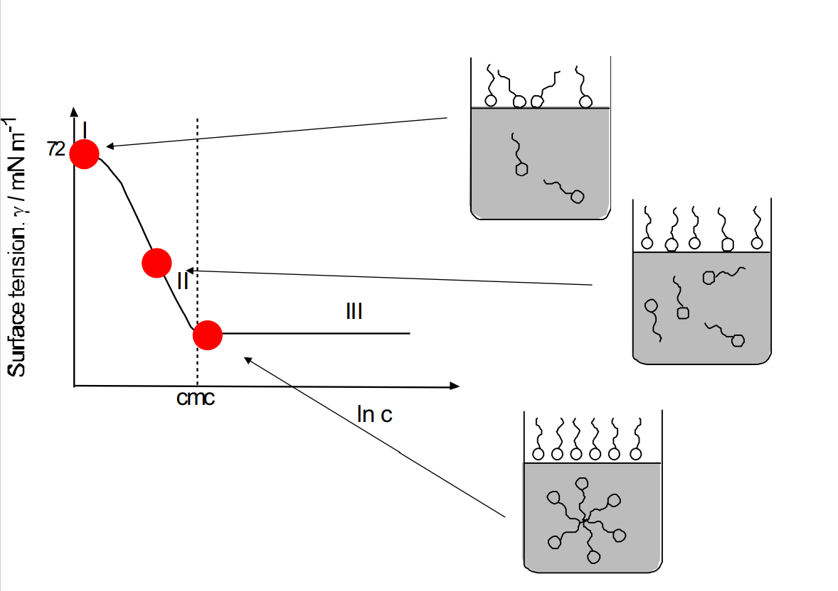
Surface activity and surface tension
Correlation between surface activity and micelle formation – when the properties of the surface change we also form micelles.

Slide 25

Surface tension regimes
Consider behaviour in three regimes
(i) Regime I: Two-dimensional “ideal gas behaviour”
(ii)Regime II: Linear relationship (between 𝛾 and lnc) – Gibbs adsorption isotherm
(iii) Regime III: Increasing the concentration leads to more micelles forming in bulk, with no further changes at the surface

Slide 26
Surface excess
The Gibbs adsorption equation Relates surface excess (number of moles in excess at surface per unit area) to gradient of 𝛾 versus ln(c) plot in regime II (where this slope is linear).
For example:
Γ_{s}=10⁻⁶ mol m⁻²
1/N_{a}Γ_{s}=1.66 ✕ 10⁻¹⁸ m² per molecule
1/N_{a}Γ_{s}=1.66 nm² per molecule
The surface excess Γ_{s} may be inverted to obtain the area per molecule. So, surface tension vs concentration measurements can give us the area per molecule in surface monolayers, as well as determination of the cmc.

Slide 27
Learning Outcomes
Today we have:
Learned about different kinds of surfactant, how their molecular structure differs and how this changes their properties
Learned about the role of surfactants in the body and in medicine
Introduced the concept of surface excess and how it can be calculated

